Slide 1
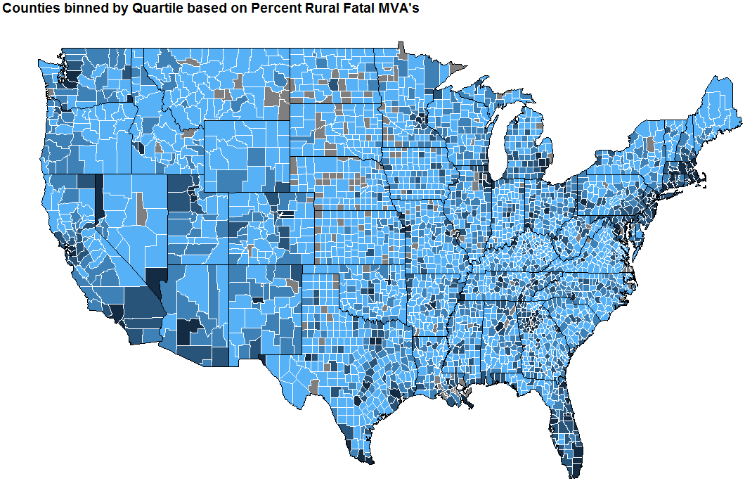
high_rural_fatal
med_high_rural_fatal
med_low_rural_fatal
low_rural_fatal

